Slide 1
SASS Presentation
my
Kevin Liang
Tony Xu
myFICO
myFICO

Slide 2

Agenda
What is Sass?
Why Sass over Less?
What are the benefits? --- How myFICO could benefit from it?
Framework and Structure
Example of Sass

Slide 3
What is Sass?
Sass stands for Syntactically Awesome Style Sheets.
It's a CSS-preprocessor.
Sass includes feature like variables, nesting, mixins, functions, and more.
SCSS stands for Sassy Cascading Style Sheet.

Slide 4
SASS vs SCSS Format Syntax
SASS
.content
color: green
padding: 0
margin: 10px 20px
SCSS
.content {
color: green;
padding: 0;
margin: 10px 20px;
}

Slide 5
Why Sass over Less?
SASS Pro
Better mixins, nested (sub nest), extends
Better function calculation (reuse methods and logic)
Minified CSS (output file easier)
More framework supports
LESS Pro
Easy installation because of JS
Better error message
Better documentation
Sass is completely compatible with all versions of CSS.
Better framework (Compass):
Simple and lightweight mixin library for Sass. Compass is a collection of helpful tools and battle-tested best practices for Sass.

Slide 6



What are the benefits?
Fewer HTTP Requests by Using the @import
More Organized / Better Comments
Reduce DRY
Faster, more efficient, and easier to maintain.
How myFICO could benefit from it?

Slide 7

The Structure – Partials/Folder
Base
Framework
Modules
Shared
Vendor
Myf_style.css

Slide 8

Structure – Base Folder
Function: Output from a function is a to return a single value of data type: numbers, strings, colors, booleans, or lists
Mixins: Reuse the block of code. Reduce dry. Also could pass arguments. Like include. ex: browser prefixes
Placeholder: Use to extend
Variable: Declare a variable to be used later on. storing the information. ex: color hex

Slide 9

Section Slide with Photo Layout, Title Goes Here
This photo can be replaced with another image of your choice. To change photos:
Click on the photo and delete it
In the underlying gray box, click on the center icon, navigate to your photo and click Insert
Optional Subtitle Goes Here

Slide 10
Title, Subtitle and Two Columns Layout ‒ Will Automatically Wrap to Two Lines if Needed
Subtitle
Text level 1
Text level 2
Text level 3
Text level 1
Text level 2
Text level 3

Slide 11
Title, Subtitle, Content and Wide Photo Layout ‒ Will Automatically Wrap to Two Lines if Needed
Subtitle
Text level 1
Text level 2
Text level 3
This photo can be replaced with another image of your choice. To change photos:
Click on the photo and delete it
In the underlying gray box, click on the center icon, navigate to your photo and click Insert

Slide 12
Title, Subtitle, Content and Wide Photo Layout ‒ Will Automatically Wrap to Two Lines if Needed
Subtitle
Text level 1
Text level 2
Text level 3
This photo can be replaced with another image of your choice. To change photos:
Click on the photo and delete it
In the underlying gray box, click on the center icon, navigate to your photo and click Insert

Slide 13
Why Sass over Less?
Sass is completely compatible with all versions of CSS.
Most mature, stable, and powerful professional grade CSS extension language in the world.
Better nesting (includes sub nest), better Mixins
Better framework:
Compass: Simple and lightweight mixin library for Sass. Compass is a collection of helpful tools and battle-tested best practices for Sass.

Slide 14
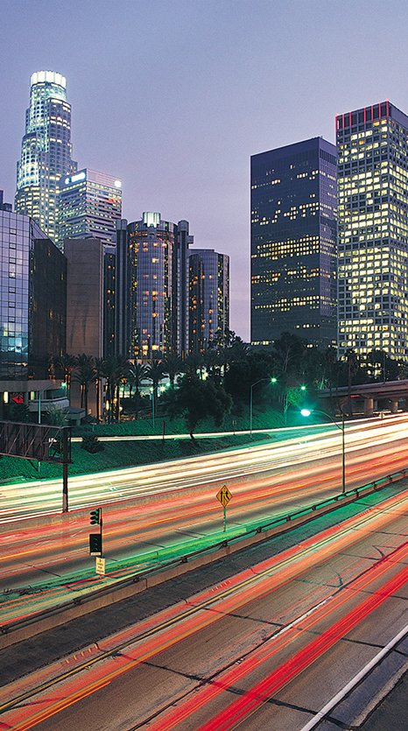
SCSS File
Text level 1
Text level 2
Text level 3
This photo can be replaced with another image of your choice. To change photos:
Click on the photo and delete it
In the underlying gray box, click on the center icon, navigate to your photo and click Insert

Slide 15

Title, Subtitle, Content and Narrow Photo Layout ‒ Will Automatically Wrap to Two Lines if Needed
Subtitle
Text level 1
Text level 2
Text level 3
This photo can be replaced with another image of your choice. To change photos:
Click on the photo and delete it
In the underlying gray box, click on the center icon, navigate to your photo and click Insert

Slide 16
What are the benifits?
Fewer HTTP Requests by Using the @import
More Organized / better comments
Text level 1
Text level 2
Text level 1
Text level 2

Slide 17


Case Study Example – Utilities
Transforming Utility Collections with Multichannel Capabilities
Enhance onshore and offshore call center performance with an automated solution
Enhance auto-resolve and speak- with-agent options to drive pay/promise-to-pay results
FICO® Risk Intervention Manager Portfolio Manager Rules Engine
50% reduction in cost per pound collected
13% increase in overall customer contact
4.5% increase in card payments
3.6% increase in overall payments
Improved customer service and results visibility

Slide 18
“Is it over yet?”
Kevin Liang

Slide 19
Thank you

Slide 20
Big Message layout. Use for single, bold statements (not quotes).

Slide 21
Pie Chart
Subtitle
100% = xxx
* Footnote 1
** Footnote 2

Slide 22
Column Chart
Subtitle
* Footnote 1
** Footnote 2

Slide 23
Line Chart
Subtitle
* Footnote 1
** Footnote 2

Slide 24
Table Example
Subtitle
 | Heading | Heading | Heading | Heading | Heading
Category | Text | Text | Text | Text | Text
Highlighted category | Text | Text | Text | Text | Text
Category | Text | Text | Text | Text | Text
Category | Text | Text | Text | Text | Text

Slide 25
Title and Full Slide Photo Layout
 | Heading | Heading | Heading | Heading | Heading
Category | Text | Text | Text | Text | Text
Highlighted category | Text | Text | Text | Text | Text
Category | Text | Text | Text | Text | Text
Category | Text | Text | Text | Text | Text

Slide 26
Thank You
Presenter Name
Phone
Email

Slide 27
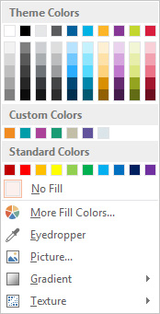
Color Scheme
Theme colors
R 255
G 255
B 255
R 0
G 0
B 0
R 230
G 231
B 232
R 90
G 91
B 93
R 0
G 96
B 156
R 0
G 179
B 228
R 253
G 181
B 40
R 135
G 55
B 149
R 195
G 214
B 46
R 217
G 30
B 62
Custom colors
R 243
G 140
B 32
R 0
G 157
B 69
R 172
G 67
B 153
R 24
G 155
B 116
R 194
G 190
B 167
R 114
G 87
B 163
R 219
G 229
B 234

